Slide 1


Slide 2
Group Members:
Talha Tariq
Amna younis
Hijab Fatima
Nadeem Abbas
Nazish Hameed
Bushra Ramzan

Slide 3
Presentation Topic:
Concept of Validity and Reliability

Slide 4
Validity:
In research, validity refers to the degree to which a study or a measurement instrument accurately measures what it is intended to measure. Essentially, it's about the truthfulness and accuracy of the findings, ensuring that the conclusions drawn from the researchare reliable and applicable.

Slide 5
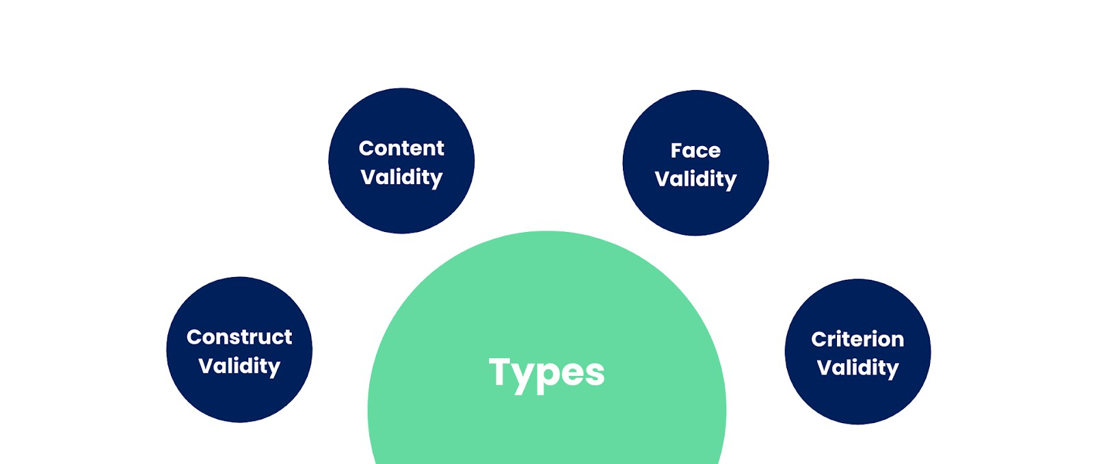
Validity in Research

Slide 6
Construct Validity:
To establish construct validity, the company must carefully design the survey questions based on existing knowledge about customer satisfaction indicators.
They should include questions specifically related to product performance, features, and overall experience, excluding irrelevant factors.

Slide 7
Content Validity:
Content validity examines whether a test adequately represents all aspects of the topic being measured.
For a media and entertainment company conducting a viewer survey on a new television show, content validity ensures that the survey questions cover all essential aspects of the viewers' experience. This includes aspects like plot engagement, character development, production quality, and overall enjoyment.
If the survey overlooks key elements or includes irrelevant questions, the validity of the results is compromised, potentially leading to biased findings.

Slide 8
Face Validity:
Face validity evaluates how appropriate the content of a test appears at first glance. It shares similarities with content validity but is a more informal and subjective evaluation. Since face validity relies on personal judgment, it's often seen as the least robust form of validity. Nonetheless, it can offer insights during the early stages of method development.

Slide 9
Importance:
Validity in research is crucial because it ensures that the data and findings obtained are accurate, meaningful, and reliable. Here's why validity is important:
Credibility
Validity enhances the credibility of research findings. It ensures that the conclusions drawn from the study accurately represent the phenomenon being studied, making the research more trustworthy.

Slide 10
Accurate Decision Making
Valid research enables researchers, policymakers, practitioners, and
other stakeholders to make informed decisions based on reliable evidence. Without validity, decisions may be based on flawed or misleading information.
Generalizability
Valid research allows for the generalization of findings to broader populations or contexts. When validity is established, researchers can confidently apply their findings beyond the specific study sample or setting.

Slide 11
Characteristics:
1. Accuracy: A valid measurement provides accurate results that reflect the true value of the variable being assessed.
2. Relevance: The measurement should be relevant to the specific purpose or question being investigated.
3. Appropriateness: The results of a valid measurement should be appropriate for the intended interpretation and use of the findings.

Slide 12
4. Representativeness: A valid measure should be representative of the entire construct or concept being measured, avoiding biases or limitations.
5. Specificity: Validity is often assessed within a specific context or for a particular interpretation. A measurement may be valid for one purpose but not another.
6. Relationship to Reliability: While not the same, validity and reliability are related. A reliable measurement is consistent, but it may not be valid if it consistently measures the wrong thing.

Slide 13
Realiability:
In research, reliability refers to the consistency and dependability of a measurement or research method. It means that the same method, when applied under similar conditions, should yield similar results each time.
A reliable measure consistently provides the same results, suggesting it's free from random error and provides a stable indication of what it's intended to measure.

Slide 14
How do you assess reliability in research?
To determine if your research methods are producing reliable results, you must perform the same task multiple times or in multiple ways.
Typically, this involves changing some aspect of the research assessment while maintaining control of the research.
For example, this could mean:
Using the same test on different groups of people
Using different tests on the same group of people.
Both methods maintain control by keeping one element exactly the same and changing other elements to ensure other factors don't influence the research results.

Slide 15
Types of Realiability:
• Test-Retest Reliability:
This checks if the results stay the same when the same test is given to the same group of people at two different times.
• Inter-Rater Reliability:
This looks at how much different people (like observers or researchers) agree when they measure the same thing.
• Internal Consistency:
This checks if all the questions or items in a test are measuring the same idea.
• Parallel Forms Reliability:
This checks if two different versions of the same test give similar results.

Slide 16
Why Reliability Is Important:
Trust in Results:
Reliable research gives us more confidence in the results because they are less likely to be random or by luck.
Use in Other Situations:
If a study is reliable, it can be repeated in different places or with different people and still give similar results. This makes the findings more useful in general.
Good Quality Data:
Reliable data helps us make correct conclusions and smart decisions.

Slide 17
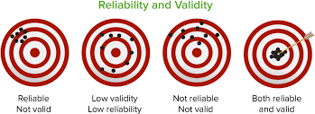

Slide 18


